Slide 1
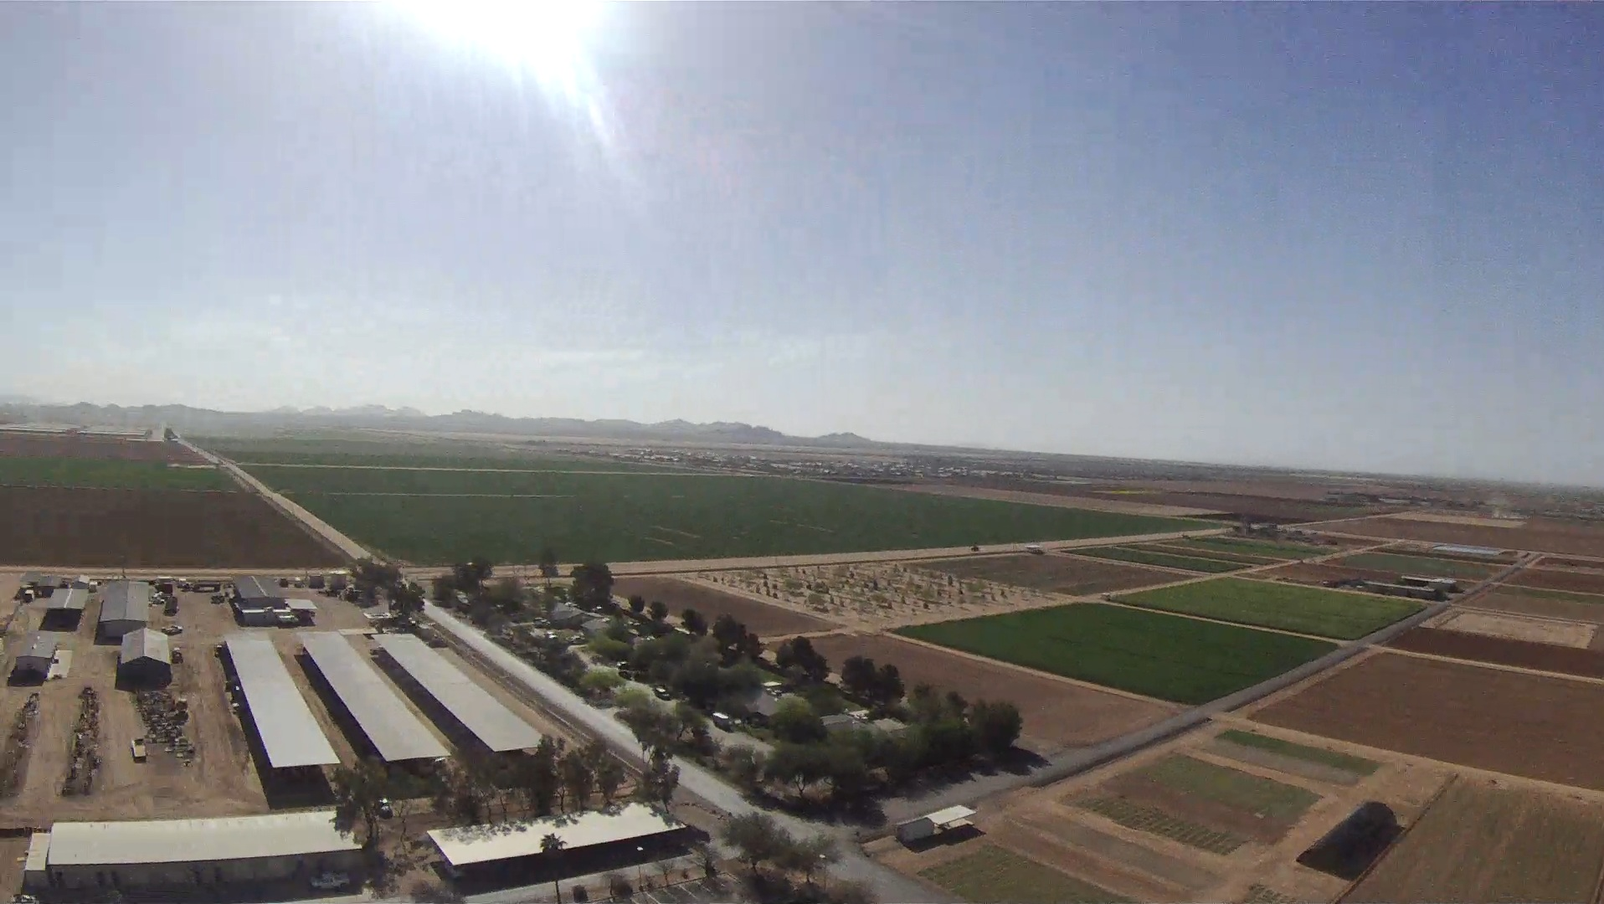




Weather Balloon Project
ECE 298
Team
Members
TJ Sullivan
Curt Watson
Matt Salazar

Slide 2
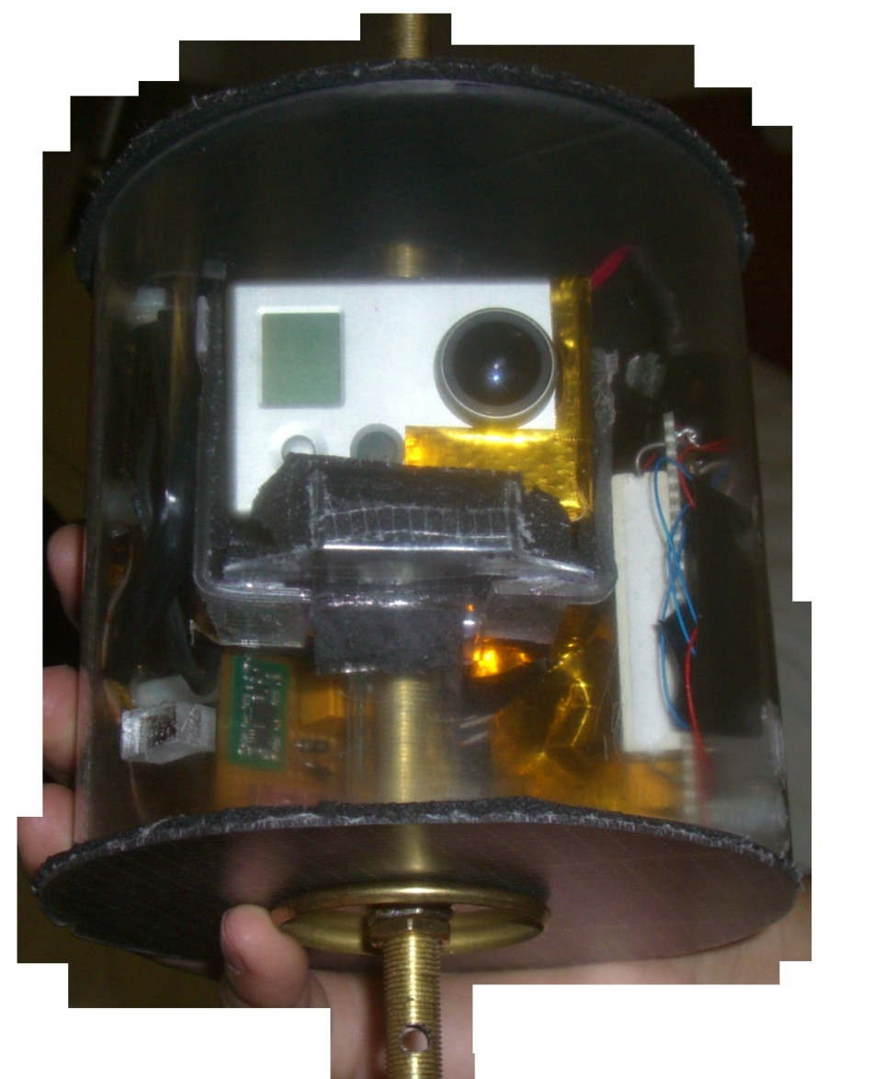
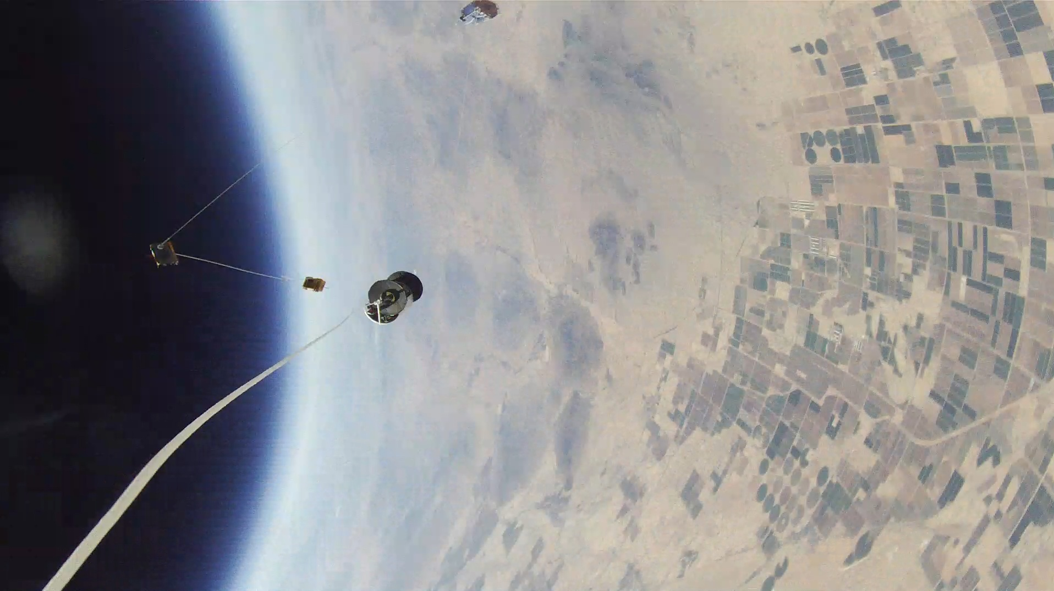
The Capsule
Structure:
Plexiglass tube
(5” wide & 1/8” thick)
Lids are Plexiglass
(5.1” wide .05 thick)
Center
(.5” inner hole, .25 wall)
Insulation:
Foam insulation tape
Gold heat reflective film

Slide 3
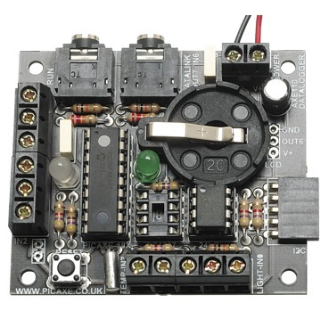
PICAXE Data Logger
The PICAXE datalogger is a complete and pre-assembled 4 channel datalogger, supplied with PICAXE-18M2, LDR light sensor and digital temperature sensor. Uses easily expandable i2c EEPROM to store data, and additional sensors can be added as desired.

Slide 4
Sensors
Digital internal temperature sensor
Digital external temperature sensor
Barometer
Accelerometer

Slide 5
Extras
Control heater through picaxe
Control camera through picaxe

Slide 6
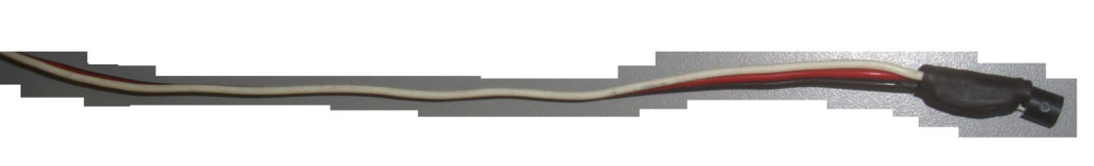
Temperature Sensors
The DS18S20 is a digital temperature sensor that will output temperatures between –55 to + 125 degrees Celsius. This makes it simple to solder to wires or printed circuit boards
We ran an internal and external temperature sensor. We did this so we would know how well our capsule was insulated. The internal sensor would be used to control our heater and come on at zero degrees Celsius and turn off when it would go back above this temperature. This would be controlled through picaxe.

Slide 7
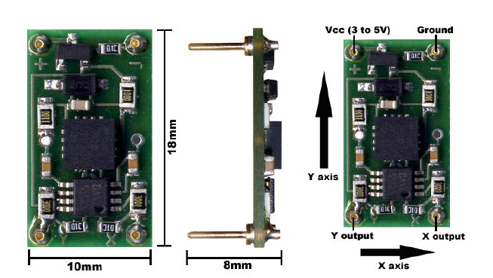
Accelerometer (x/Y)
Dual axis ±5g sense range
Up to 312mV/g sensitivity
Operating voltage 3 to 5V
Reverse voltage protection
Overvoltage protected up to 14V
Output short protection
Draws under 2mA

Slide 8
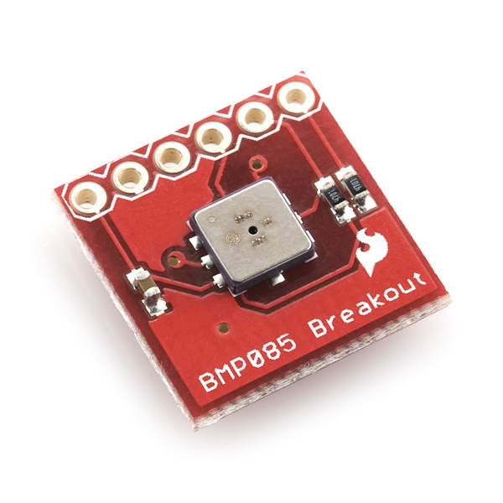
barometer
Pressure range:
300 to 11OOhPa (+9000m to 500m above sea level)
Supply voltage:
1.8 ..... 3.6v (V0o4)
1.62V ...3.6V (VDoo)
Dimensions:
5.0mm L x 5.0mm W x 1.2mm H
Low power:
5pA at 1 sample /sec.
Power mode
0.O3hPa (0.25m
I2C interface

Slide 9
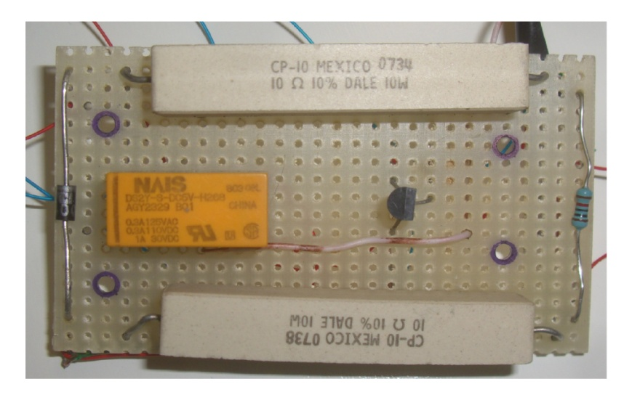
Heater:
Materials:
*2 ceramic resistors
*Fuse(2amp)
*10K resistor
*Transistor (2N2222)

Slide 10
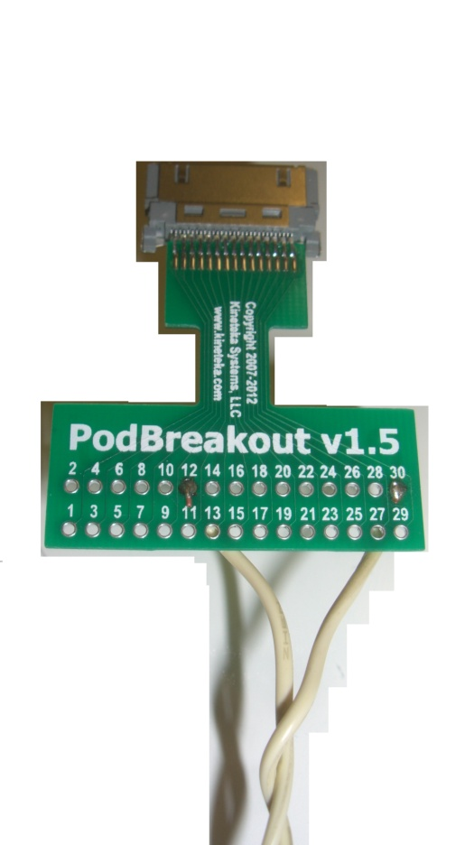
Podgizmo:
We used this to ground the camera. It would turn the camera on and off as to conserve the battery. Now we could focus on what we felt would be the most interesting parts of the flight.

Slide 11
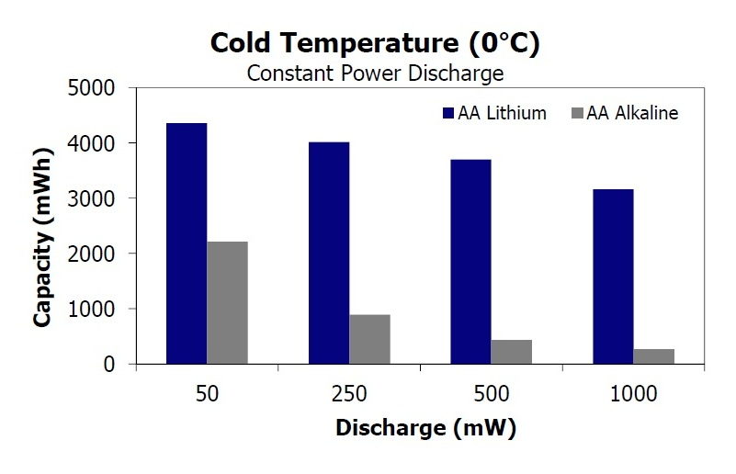

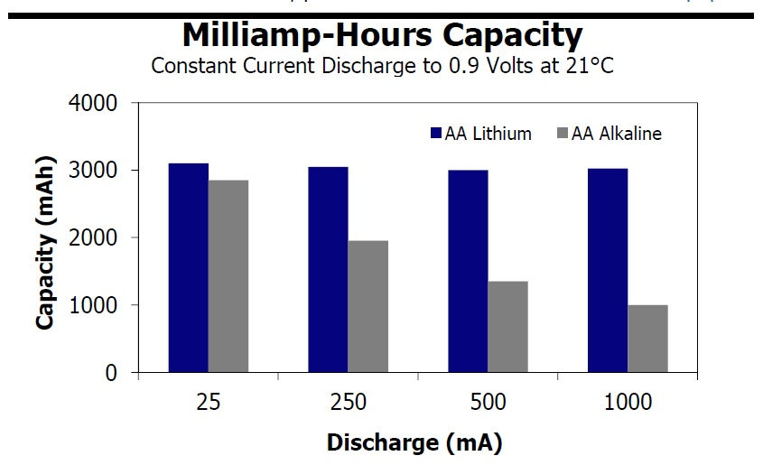
battery:
Energizer Ultimate Lithium AA
Temperature range:
-40 º F to 140º F
Weight:
14.5g

Slide 12
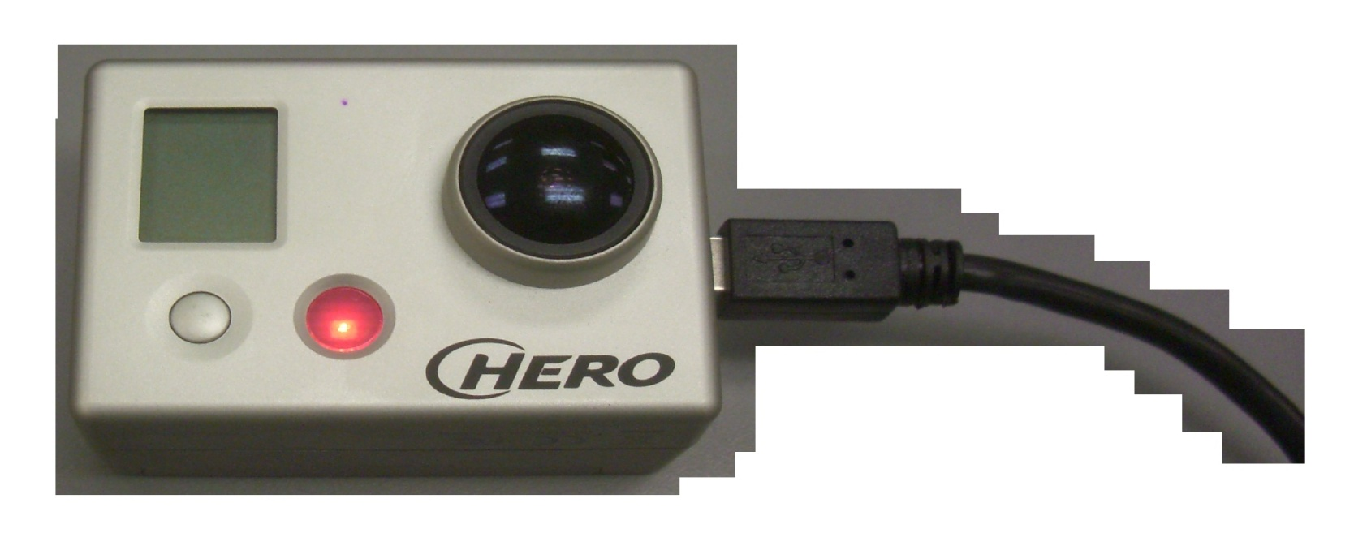
GoPro HD Hero
Stats:
1080p: 1920x1080 pixels (16:9), 30 fps, 15 Mbit/s data rate
960p: 1280x960 pixels (4:3), 30 fps, 12 Mbit/s data rate
720p: 1280x720 pixels (16:9), 30 fps with 8 Mbit/s data rate,or 60 fps with 15 Mbit/s data rate

